Slide 1


Status Report TTbar Angular Distributions NTUA
George Bakas

Slide 2
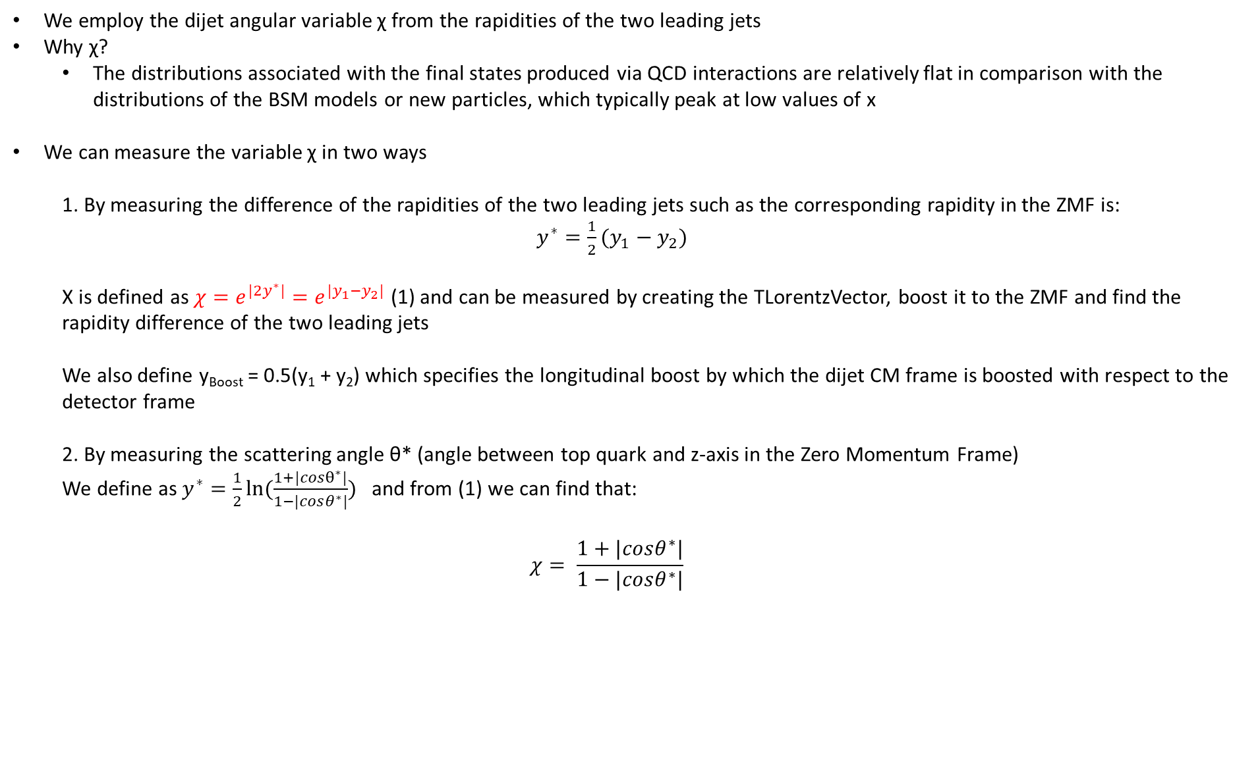
Variables
We employ the dijet angular variable χ from the rapidities of the two leading jets
Why χ?
The distributions associated with the final states produced via QCD interactions are relatively flat in comparison with the distributions of the BSM models or new particles, which typically peak at low values of x
We can measure the variable χ in two ways
1. By measuring the difference of the rapidities of the two leading jets such as the corresponding rapidity in the ZMF is: $y^{∗}=\frac{1}{2}(y_{1}−y_{2})$
Χ is defined as $χ=e^{{|2y}^{∗}|}=e^{|y_{1}−y_{2}|}$ (1) and can be measured by creating the TLorentzVector, boost it to the ZMF and find the rapidity difference of the two leading jets
We also define y_{Boost} = 0.5(y₁ + y₂) which specifies the longitudinal boost by which the dijet CM frame is boosted with respect to the detector frame
2. By measuring the scattering angle θ* (angle between top quark and z-axis in the Zero Momentum Frame)
We define as $y^{∗}=\frac{1}{2}ln⁡(\frac{1+|cosθ^{∗}|}{1−|cosθ^{∗}|})$ and from (1) we can find that:
$$χ= \frac{1+|cosθ^{∗}|}{1−|cosθ^{∗}|}$$

Slide 3
Response Matrices
Selection:
Parton: partonPt > 400, |partonEta|< 2.4, mTTbarParton > 1000
Reco: jetPt>400, |jetEta| < 2.4, nLeptons ==0
Btagging Medium working point
Top tagger mva > 0.3
Jet mass soft Drop (120, 220)GeV
Jets are matched
Response matrix of χ_{reco}, χ_{parton} with {1,2,3,4,5,6,7,8,9,10,13,16} as variable binning
Response matrix of |cos(θ)|_{reco}, |cos(θ)|_{parton} 10 bins in [0,1] region
Stability, Efficiency for χ, |cos(θ)| distributions
Acceptance and purity for χ and |cos(θ)|distributions
I measure the χ using the exponential

Slide 4

Response Matrices
Selection:
Jet Matching
Parton cuts:
partonPt[0],[1] > 400
|partonEta[0],[1]| < 2.4
mTTbarParton > 1000
Reco cuts:
nJets > 1
nLeptons = 0
mJJ > 1000
jetPt[0],[1] > 400
|jetEta[0],[1]| < 2.4
bTagging (Medium WP)
Tagger cut (event mva, top Tagger, deepAK8)
JetMassSoftDrop > 120 and < 220
Definitions:
$$Efficiency= \frac{\#events passing reco and parton cuts}{\#events passing parton cuts from EventCounter} \left(vs Parton\right)$$
$$Acceptance= \frac{\#events passing reco and parton cuts}{\#eventsing pass reco cuts }(vs Reco)$$

Slide 5
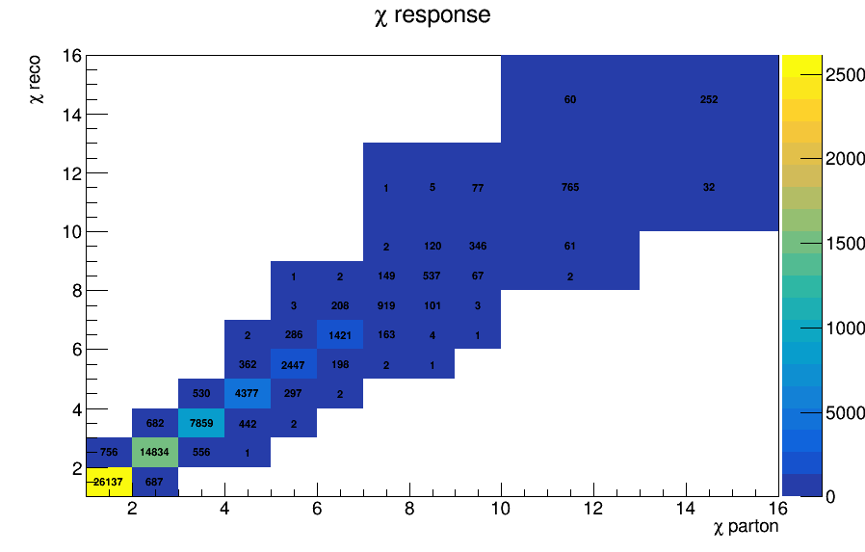
Response Matrix for χ

Slide 6
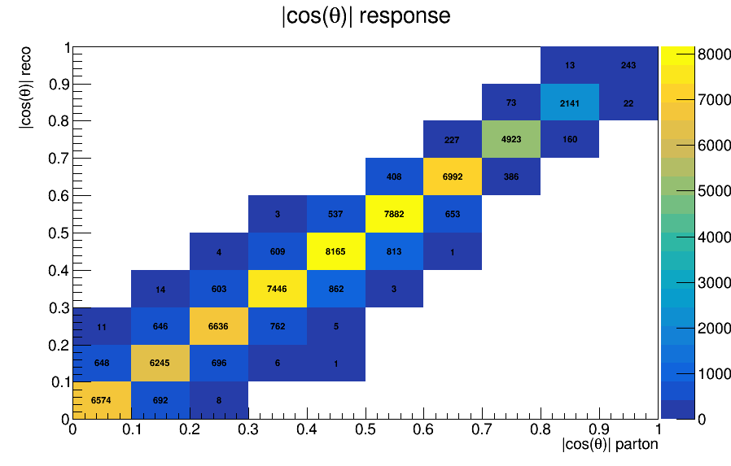
Response Matrix for |cos(θ)|

Slide 7
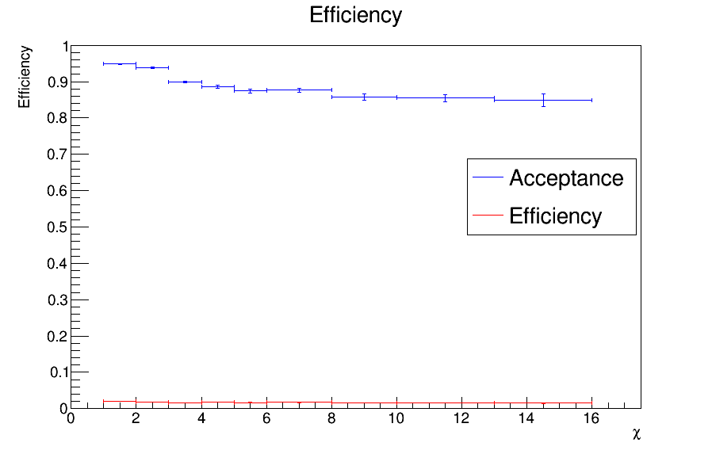
Efficiency and Acceptance for chi distribution

Slide 8
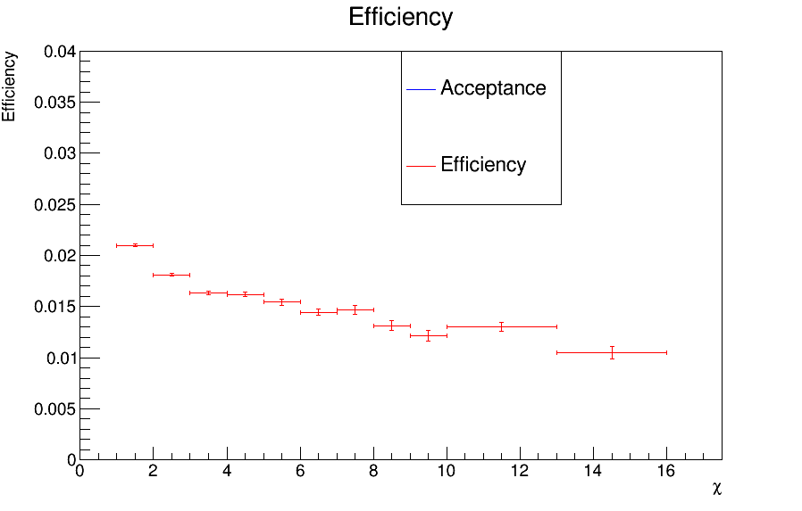
Efficiency for chi distribution (zoomed)

Slide 9
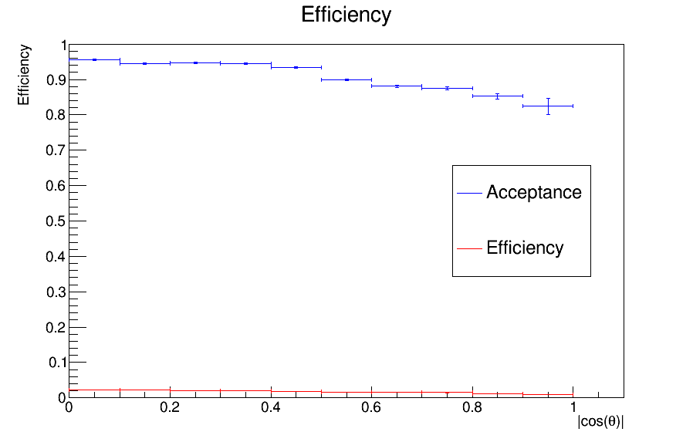
Efficiency and Acceptance for |cos(θ)| distribution

Slide 10
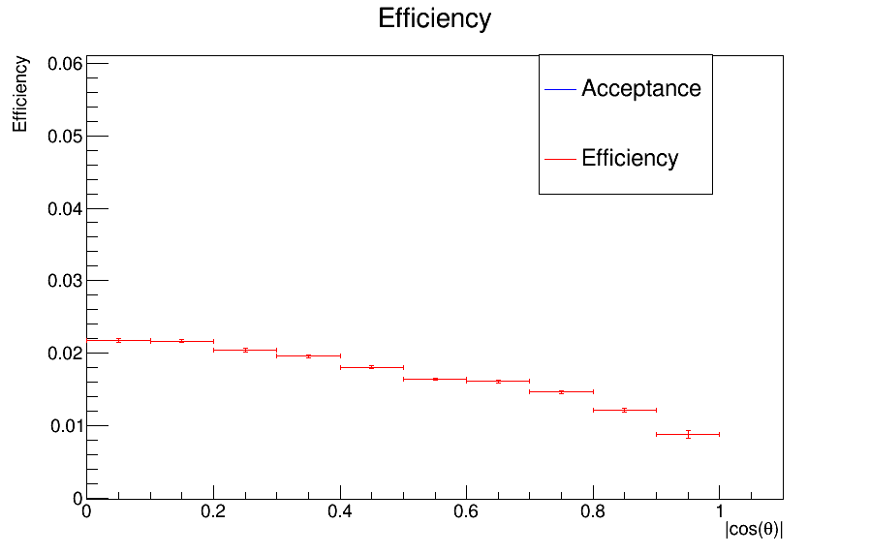
Efficiency for|cos(θ)| distribution (zoomed)

Slide 11
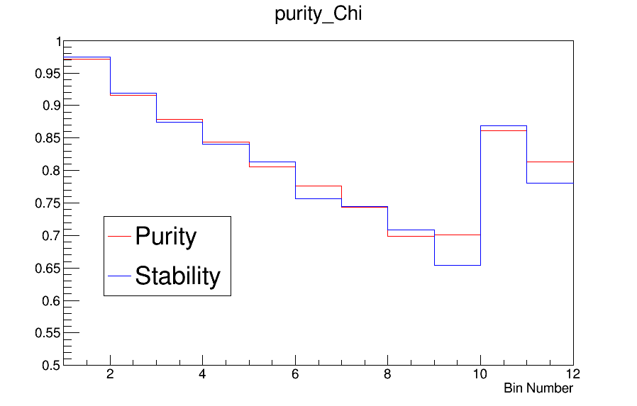
Purity and Stability for chi distribution

Slide 12
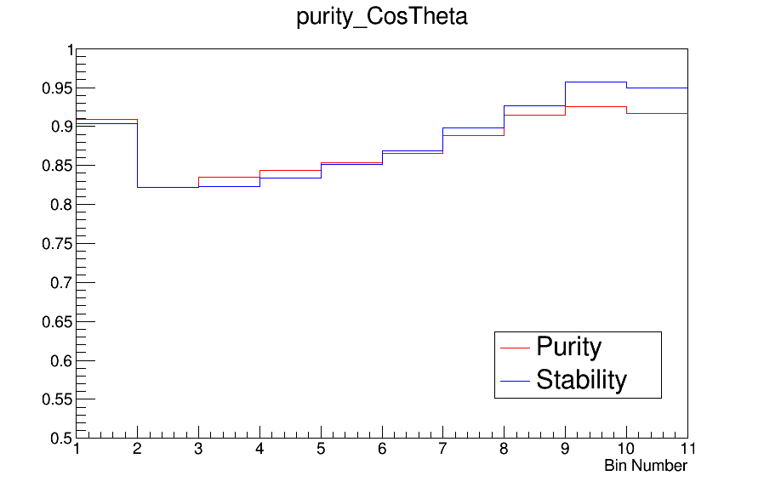
Purity and Stability for |cos(θ)| distribution

Slide 13
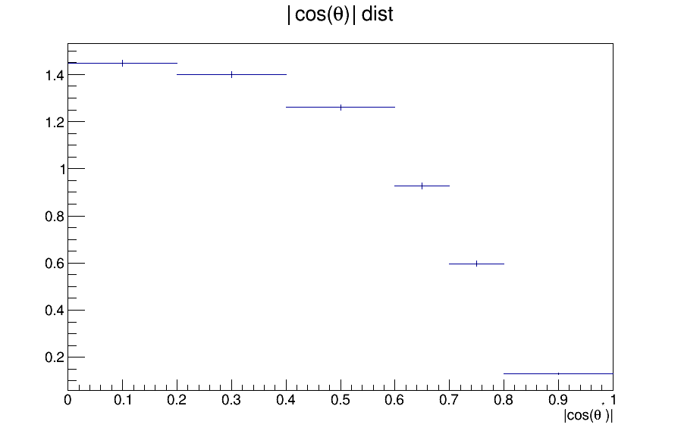
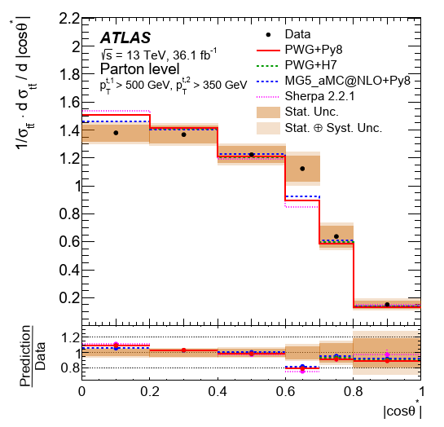
Comparisons with ATLAS |cosθ| distributions
cut at Pt here is >500 as in ATLAS analysis

Slide 14
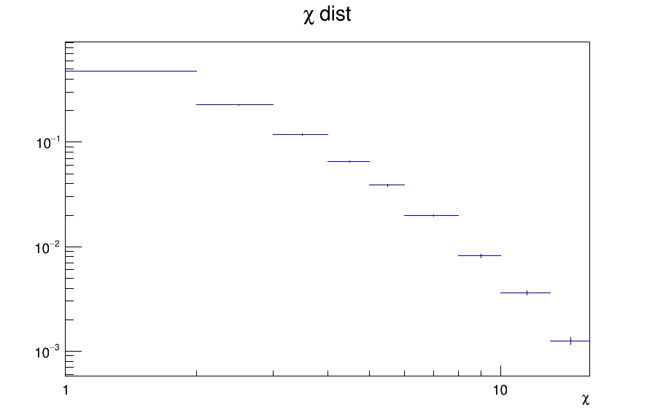
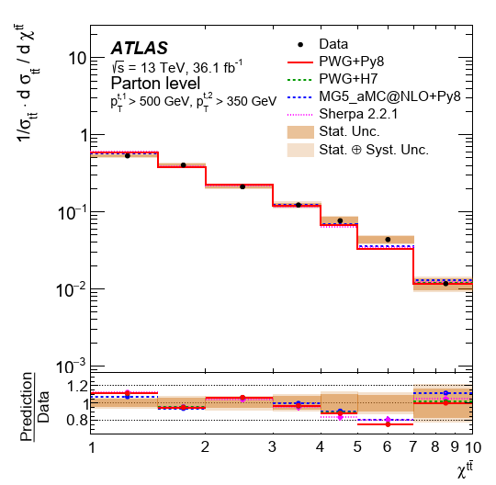
Comparisons with ATLAS χ distributions
cut at Pt here is >500 as in ATLAS analysis

Slide 15
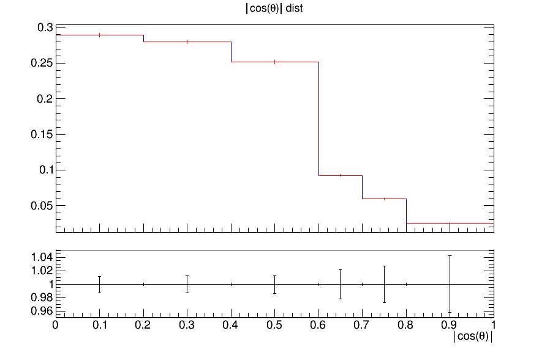
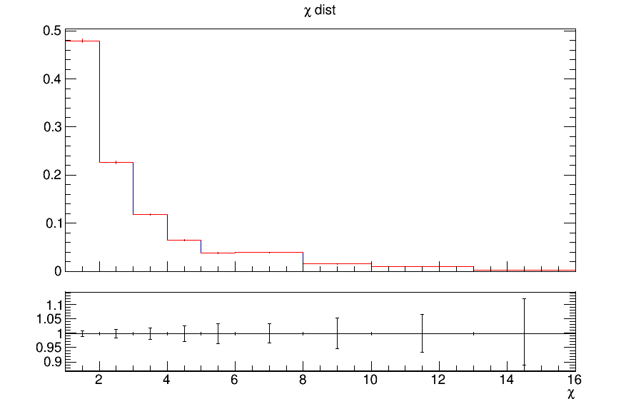
QCD Measurement vs Search
In exotica searches, an |y_{Boost}|<1.19 cut is applied
Are there any differences when we don’t aply the cut?
|cosθ| With boost cut
χ With boost cut
|cosθ|
χ

Slide 16
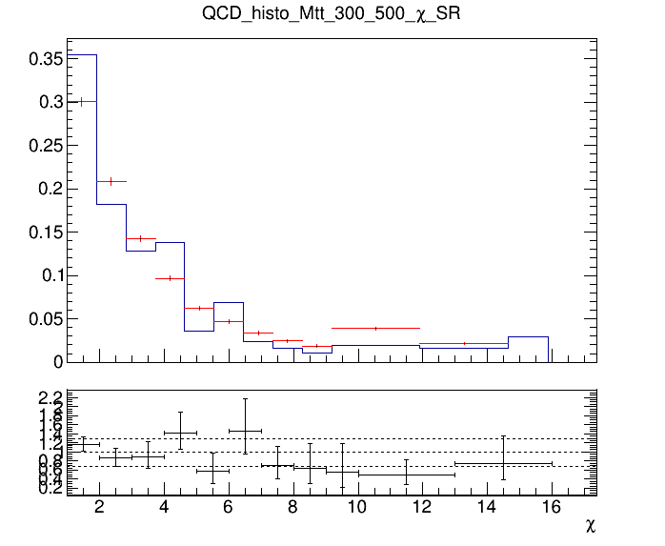
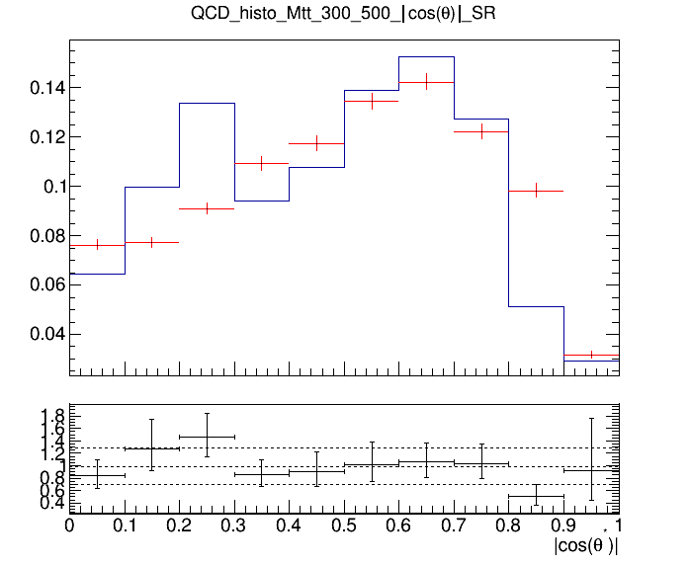
QCD Background MC closure tests
Closure test for QCD samples in Control Region (SR but btagging is reverted (btag==0))
Control Region (0-btag)
Control Region (0-btag)
Signal Region (2-btag)
Signal Region (2-btag)

Slide 17
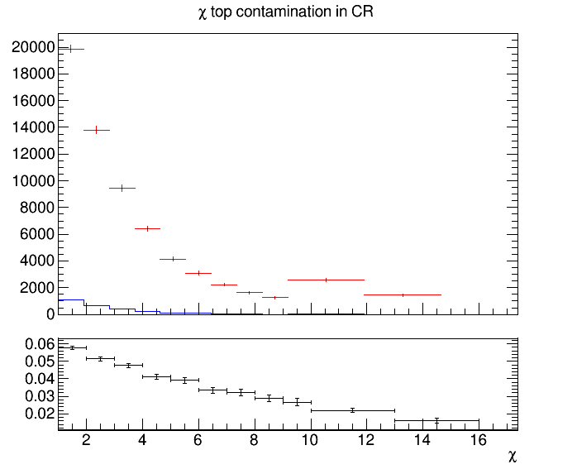
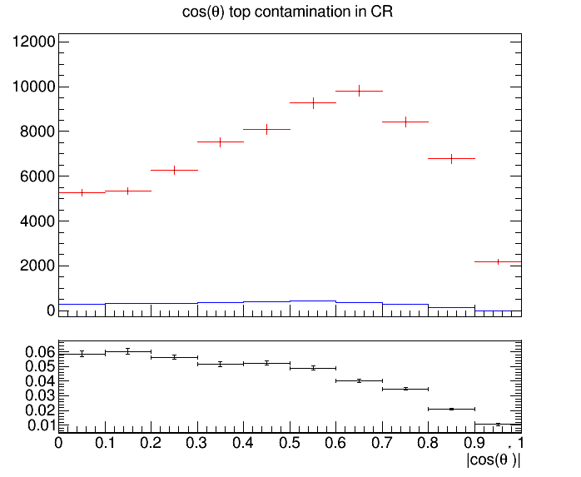
Control Region Contamination
Expected yield from QCD Bkg samples and TT Signal sample in the CR
Control Region QCD sample
Control Region QCD sample
Control Region TT sample
Control Region TT sample

Slide 18
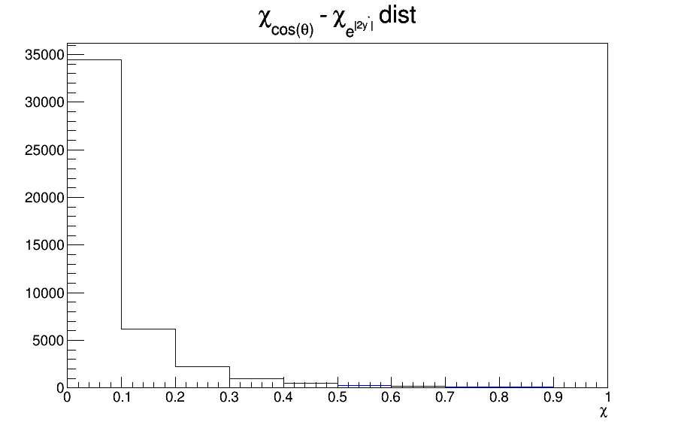

Comparison on how to measure x value
$e^{\left|2y^{∗}\right|}$
$χ= \frac{1+|cosθ^{∗}|}{1−|cosθ^{∗}|}$

Slide 19
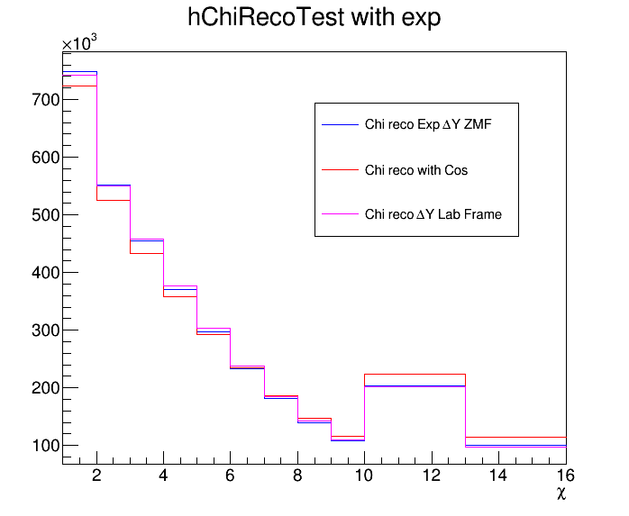
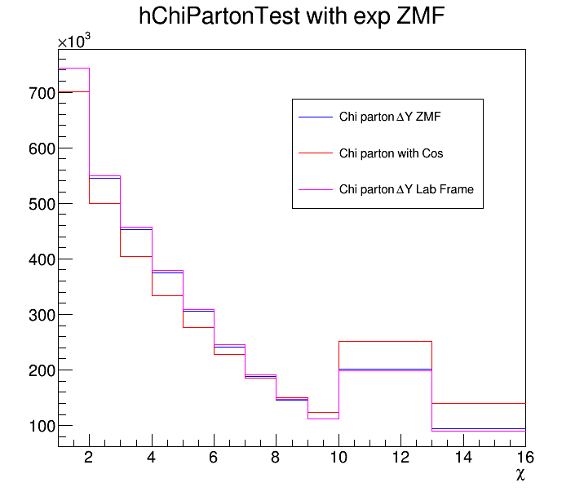
Measuring Chi in different ways in Parton and Reco Phase Space
Measurement of chi
Using exponential and abs(y1-y2) in the Lab frame
Using exponential and abs(y1’-y2’) in the ZMF
Using cos(theta)

